Slide 1

Networking in Python

Slide 2

Objectives
In this session, you will learn to:
Extract Data Using Regular Expression.
Combine and Search Data.
Implement Networking in Python.
Explore HTTP.
Retrieve Images using HTTP.
Retrieve Web Pages with URL Library.

Slide 3

Extracting Data Using Regular Expression
Are Regular Expressions used to extract a particular data from a given expression?
A regular expression (regex for short) is a special text string for describing a search pattern.
It is a pattern describing a certain amount of text.
Notes:
A regular expression (regex for short) is a special text string for describing a search pattern. It is a pattern describing a certain amount of text.
Whether Regular Expressions are used to extract a particular Data from a given Expression?

Slide 4
Extracting Data Using Regular Expression (Contd.)
Findall ()
Extracts data from a string.
Returns all non-overlapping matches of pattern in string.
Scans data from left-to-right and returns exact match.
Returns a list of groups if one or more groups found.
re.findall(pattern, string[, flags])
Notes:
Findall() method will return a list of tuples if the pattern has more than one group. Empty matches are included in the result unless they touch the beginning of another match.
Findall() will return a list of tuples, where the Nth element of each tuple corresponds to the Nth group of the regex pattern
Characteristics of findall() method :
It is Used to extract data from a string.
It returns all non-overlapping matches of pattern in string, as a list of strings.
The string is scanned left-to-right, and matches are returned in the order found.
If one or more groups are present in the pattern, return a list of groups.

Slide 5
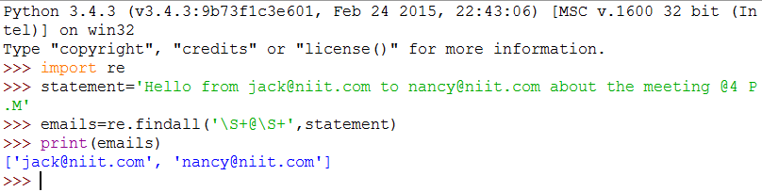
Extracting Data Using Regular Expression (Contd.)
Let us look at an example of extracting the e-mail address from a certain statement.
Output:
[‘jack@niit.com', ‘nancy@niit.com']
Notes:
The findall() method searches the string in the second argument and returns a list of all of the strings that look like e-mail addresses.
We are using a two character sequence that matches a non-whitespace character (\S).

Slide 6
Combining, Searching and Extracting
findall() extracts a line or string that matches specified pattern
findall() can also be used to segregate portions of a string
Example for searching using regular expression
import re
hand = open('mbox-short.txt')
for line in hand:
line = line.rstrip()
x = re.findall('ˆX\S*: ([0-9.]+)', line)
if len(x) > 0 :
print x
Notes:
In findall() method the parenthesis indicate that while we want the whole expression to match we only are interested in extracting a portion of the substring that match the regular expression.

Slide 7
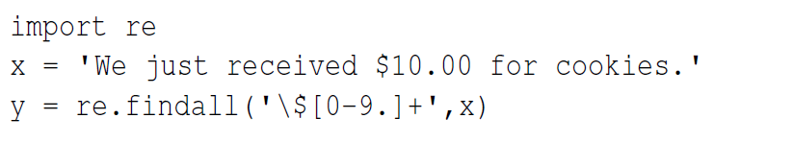
Escape Character
Escape Characters are an alternative interpretation on subsequent character sequence.
Escape Characters are used in Regular Expression to indicate normal character and match the actual character such as dollar sign or caret.
Notes:
Escape Character are an alternative interpretation on subsequent character sequence.
An escape character is a particular case of meta characters.
Escape characters are part of the syntax for many programming languages.
In many programming languages an escape character also forms some escape sequence which are referred to control characters.
In the code mentioned above, since we prefix the dollar-sign with a backslash, it actually matches the dollar-sign in the input string instead of matching the “end of line” and the rest of the regular expression matches one or more digits or the period character. When we say “[0-9.]”, it really means digits or a period.

Slide 8

Just a Minute
Predict the output of the following code
string = “Once you have accomplished small things, you may attempt great ones safely.”
print re.findall(r"\ba[\w]*", string)

Slide 9
Just a Minute
Predict the output of the following code
string = “Once you have accomplished small things, you may attempt great ones safely.”
print re.findall(r"\ba[\w]*", string)
Answer:
['accomplished', 'attempt']
Notes:
Solution:
['accomplished', 'attempt']

Slide 10
Activity
Activity : Understanding & Implementing Regular Expression
Problem Statement
Write a program to simulate the operation of the grep command in Unix. Ask the user to enter a regular expression and count the number of lines that matched the regular expression.
Here is a sample execution of the program:
Enter a regular expression: ˆAuthor
mbox.txt had 1798 lines that matched ˆAuthor
Enter a regular expression: ˆX
mbox.txt had 14368 lines that matched ˆX
Enter a regular expression: java$
mbox.txt had 4218 lines that matched java$
Prerequisite: For this activity please refer “mbox.txt” available inside “Data_File_For_Students” folder.
Notes:
Solution:
Prerequisite: For this activity you need to use mbox.txt which is available with Data_File_For_Students.
In order to do this activity, you need to perform the following tasks:
Create an empty Python project.
Use re library to access regular expression methods, use rstrip() to break line into part and use search() to search specified pattern with part of string.
Task 1: Create a Python empty project:
Step 1: Open NetBeans 8.0.2.
Step 2: Click File menu.
Step 3: Select New Project.
Step 4: Select Python from Categories list and Python Project from Projects list.
Step 5: Click Next button.
Step 6: On New Python Project dialog box set the Project Name as CR_Session13_Activity01.
Step 7: Select project Location by clicking Browse button.
Step 8: Click Finish button.
Task 2: Use re library to access regular expression methods, rstrip() to break line into part and search() to search specified pattern with part of string:
Step 1: Type the following code:
import re
hand = open("mbox.txt")
search = raw_input("Enter a regular expression: ")
count = 0
for line in hand:
line = line.rstrip()
if re.search(search,line) :
count = count + 1
print("mbox.txt had "+str(count)+" lines that matched "+search)
Step 2: Run the program.

Slide 11
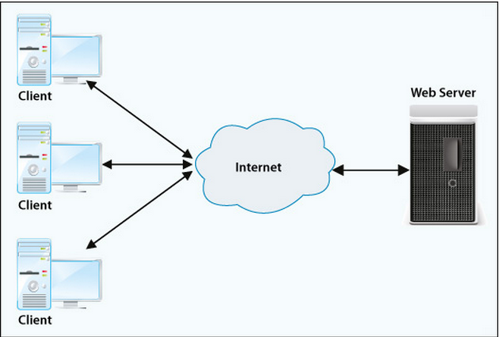
Network Programming
Networking is concept of two programs communicating across a network.
Whether it be from client-client, client-server or even client to itself.
Client : An end device interfacing with a human.
Server : A device providing a service for clients.
Notes:
Networking is the concept of two programs communicating across a network. Whether it be from client- client, client-server or even client to itself.
User interface is used by the client to interact with the server. Server can be Application Server or Web Server or Database Server.

Slide 12
HyperText Transfer Protocol – HTTP
HTTP is an application protocol for distributed, collaborative information systems.
HTTP is a foundation of data communication for the WWW.
Http Request
Client
Server
Http Response
Notes:
The Hypertext Transfer Protocol (HTTP) is an application protocol for distributed, collaborative, hypermedia information systems. HTTP is the foundation of data communication for the World Wide Web.
Protocol is a set of rules used for network communication.
It determines what has to go first and what operations to be performed and what are the responses.

Slide 13
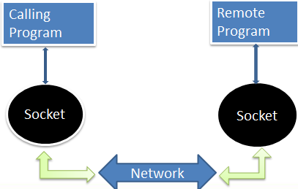
Understanding Sockets
Sockets are endpoints of a bidirectional communications channel.
Sockets are much like a file except that it provides a two way connection between two programs with a single socket
Notes:
Python provides two levels of access to network services at a low level where we can access the basic socket support.
Python also has libraries that provide higher level access to specific application-level network protocol such as FTP,HTTP and so on.
Sockets are the endpoints of a bidirectional communications channel. Sockets may communicate within a process, between processes on the same machine, or between processes on different continents..
You can both read from and write to the same socket. If you write something to a socket it is sent to the application at the other end of the socket.
The network protocol that powers the web is actually quite simple and there is built in support in python called socket.

Slide 14
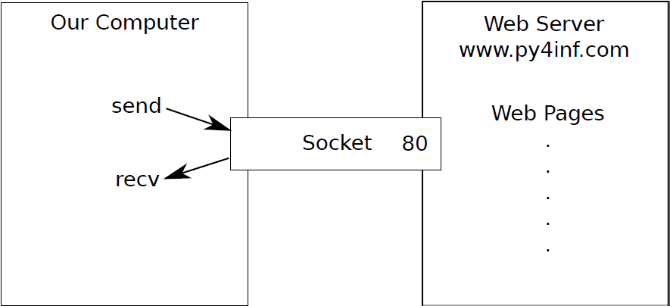
World’s Simplest Web Browser
The use of HTTP Protocol in Python Program is to make a connection to a Web Server by following the rule of HTTP protocol.
Notes:
Http protocol will follow the rules and request a document and display what the server sends back.

Slide 15
World’s Simplest Web Browser (Contd.)
The following program makes a connection to port 80 on the server and prints the data what server has sent.
import socket
mysock=socket.socket(socket.AF_INET,socket.SOCK_STREAM)
mysock.connect((‘www.py4inf.com’,80))
mysock.send(‘GET http://www.p4inf.com/code/romeo.txt HTTP/1.0\n\n’)
while True:
data=mysock.recv(512)
if(len(data)<1):
break
print data
mysock.close()
Output:
HTTP/1.1 200 OK
Date: Sun, 14 Mar 2010 23:52:41 GMT
Server: Apache
Last-Modified: Tue, 29 Dec 2009 01:31:22 GMT
ETag: "143c1b33-a7-4b395bea"
Accept-Ranges: bytes
Content-Length: 167
Connection: close
Content-Type: text/plain
Notes:
First the program makes a connection to port 80 on the server www.py4inf.com. Since our program is playing the role of the “web browser” the HTTP protocol
says we must send the GET command followed by a blank line.

Slide 16
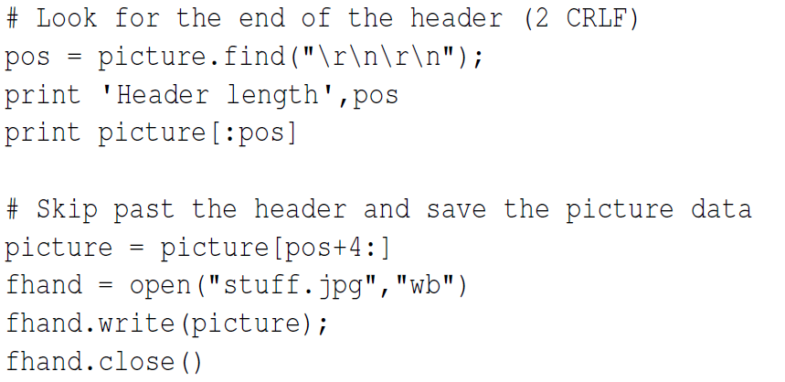
Retrieving Image over HTTP
Copying the data - Accumulate the data in a String ,trim off the headers and save the image data to a file.
$ python urljpeg.py
2920 2920
1460 4380
1460 5840
1460 7300
...
1460 62780
1460 64240
2920 67160
Header length 240
HTTP/1.1 200 OK
Date: Sat, 02 Nov 2013 02:15:07 GMT
Output
Notes:
We can see that for this URL, the Content-Type header indicates that body of the document is an image (image/jpeg). Once the program completes, we can view
the image data by opening the file stuff.jpg in an image viewer.

Slide 17
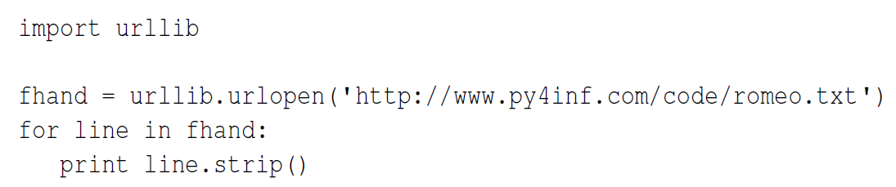
Retrieving Web Pages with “urllib”
We can manually send and receive data over HTTP using the socket library in a simpler way using “urllib”.
“urllib” will retrieve the web page which you have indicated and handles all of the http protocol and header details.
Output:
But soft what light through yonder window breaks
It is the east and Juliet is the sun
Arise fair sun and kill the envious moon
Who is already sick and pale with grief
Notes:
Once the web page has been opened with urllib.urlopen we can treat it like a file and read through it using a for loop.
When the program runs, we only see the output of the contents of the file. The headers are still sent, but the urllib code consumes the headers and only returns
the data to us as below :
But soft what light through yonder window breaks
It is the east and Juliet is the sun
Arise fair sun and kill the envious moon
Who is already sick and pale with grief

Slide 18
Just a Minute
Using _______, we can treat Web Page much like a file.

Slide 19
Just a Minute
Using _______, we can treat Web Page much like a file.
Answer:
urllib
Notes:
Solution:
urllib

Slide 20
Just a Minute
A ______ is much like a file, except that it provides a two-way connection between two programs with a single socket.

Slide 21
Just a Minute
A ______ is much like a file, except that it provides a two-way connection between two programs with a single socket.
Answer:
Socket
Notes:
Solution:
Socket

Slide 22
Activity
Activity : Implementing Network Programming
Problem Statement:
Write a socket program so that it counts the number of characters it has received and stops displaying any text after it has shown 3000 characters. The program should retrieve the entire document and count the total number of characters and display the count of the number of characters at the end of the document.
Prerequisite: Internet connection must be available to run this activity.
Notes:
Solution:
Prerequisite: Internet connection must exists to run this activity.
In order to do this activity, you need to perform the following tasks:
Create a Python empty project.
Use socket library to perform socket programming, use socket(), connect(), send(), recv() to initiate the connection and send and receive data through the connection.
Task 1: Create a Python empty project:
Step 1: Open NetBeans 8.0.2.
Step 2: Click File menu.
Step 3: Select New Project.
Step 4: Select Python from Categories list and Python Project from Projects list.
Step 5: Click Next button.
Step 6: On New Python Project dialog box set the Project Name as CR_Session13_Activity02.
Step 7: Select project Location by clicking Browse button.
Step 8: Click Finish button.
Task 2: Use socket library to avail socket(), connect(), send(), recv() of python socket programming:
Step 1: Type the following code:
import socket
url = raw_input("Enter any URL(e.g. http://www.niitstudent.com/india/studentweb/index.aspx): ")
words = url.split('/')
host = words[2]
mysock = socket.socket(socket.AF_INET, socket.SOCK_STREAM)
mysock.connect((host, 80))
mysock.send("GET "+url+" HTTP/1.0\n\n")
myList=list()
while True:
data = mysock.recv(512)
if ( len(data) < 1 ) :
break
print(data)
myList.append(data)
i=0
for word in myList:
for c in word:
if i<3000 :
i=i+1
print(i)
mysock.close()
Step 2: Run the program.

Slide 23
Summary
In this session, you learned to:
Extract Data Using Regular Expression.
Combine and Search Data.
Implement Networking in Python.
Explore HTTP.
Retrieve Images using HTTP.
Retrieve Web Pages with URL Library.

